Slide 1
Building an Efficient RDF store over a Relational Database IBM Research
Presented by
Prudhvi Raj Atluri,
Suresh Yarra,
Imrul Siddique,
Anas Katib.

Slide 2
Purpose
Due to increase in the usage of RDF in web & enterprises, we need efficient storage and querying mechanisms, that are important factors in RDF Data Management.
Since efficient management of RDF is still a open problem, the present approach works on TOP of existing relational representations.
We focus on two aspects of efficiency
Storage
Query Evaluation

Slide 3
Existing Approaches
Storage:
Existing approaches can't handle the dynamic RDF data without altering their schema. More importantly, these approaches can’t scale to large RDF stores and can’t efficiently handle many complex queries.
Querying:
Approaches that follow Bottom-Up SPARQL query optimization works well for simple SPARQL queries but it is not the same case with more complicated queries.

Slide 4
Solution
Storage:
An Innovative relational storage representation of RDF data which is both Scalable and Flexible, where there is no need to alter the storage schema.
Querying:
Introduced a Hybrid two-step approach for query optimization.
Step-1: Construct a specialized structure called Data Flow(i.e captures inter relationships)
Step-2: Use Data Flow to decide the order and plans (hybrid optimizer searches for optimal plans)

Slide 5
RDF over Relational
Earlier Attempts to store RDF as Relational:
Triple-Store: In this each RDF triple becomes a single tuple(row) in a relation.
This approach can handle dynamic RDF schema.
Querying may not be efficient, because it may lead to self joins due to large no. of tuples in the relation.
Type-Oriented: In this, relation is created for each RDF type.
Schema requires changes as new RDF types are encountered.
This can lead to more number of relations.
Predicate-Oriented: Similar to type-oriented approach, in this relation is created for each predicate.
Schema is problematic as new predicates are encountered.

Slide 6
RDF over Relational
Proposed Approach:
Entity-Oriented: This overcomes the drawbacks of existing approaches, as it offers flexibility in tuple dimension.
here columns of a relation treated as flexible storage locations, predicates are dynamically assigned to them.

Slide 7
DB2RDF Schema
Basic Components
Direct Primary Hash (DPH): It is main relation in schema where each tuple stores subject ‘s’ in the entry column and with all its associated predicates and objects stored in pred_{i} and val_{i} columns where 0≤i≤k.
If subject S has more than ‘K’ predicates i.e |pred(s)|>k then ((|pred(s)|/k)+1) tuples for ‘s’.
Here 1st triple stores first k predicates for ‘s’ and ‘s’ spills into second triple and this process continues until all predicates of ‘s’ are stored.
2. Direct Secondary Hash(DS): Multivalued predicate cannot fit into a single val_{i} we introduce a new relation called ‘DS’
While storing multivalued predicate in DPH a new unique identifier is assigned as a value of predicate.
The identifier is stored in DS Relation and is associated with each of predicate value.

Slide 8
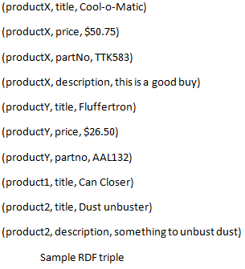
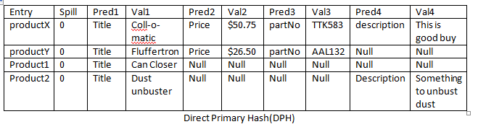
DB2RDF Schema Eg.

Slide 9
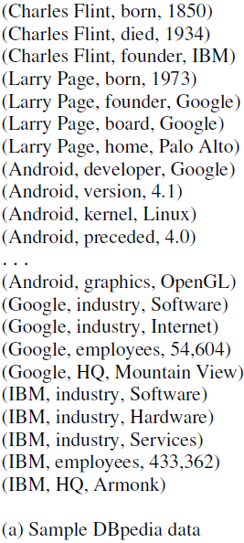
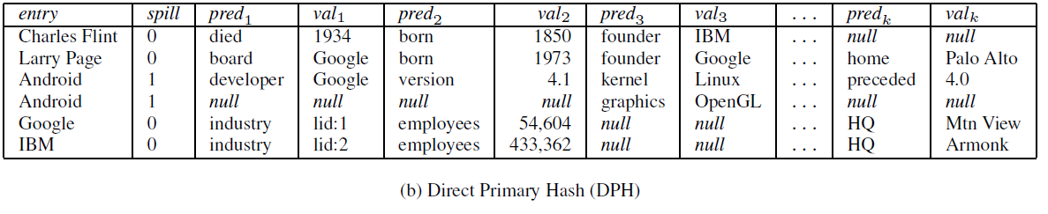
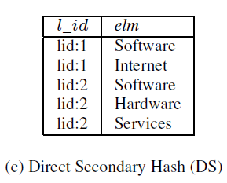
DB2RDF Schema Eg-2

Slide 10
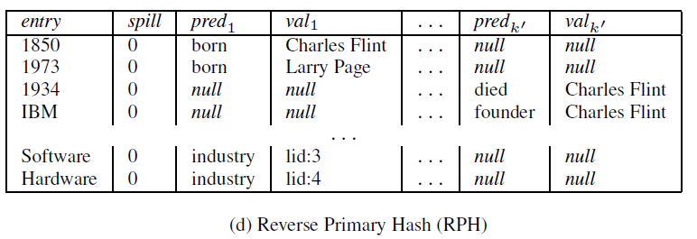
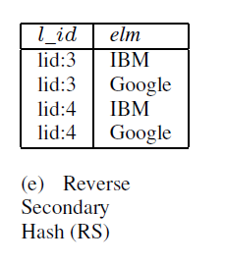
we can consider object as a entry for the primary hash table, so two additional relations are constructed, those are called as Reverse Primary Hash (RPH) and Reverse Secondary Hash (RS).

Slide 11
Advantages of DB2RDF layout
Elimination of joins in star queries(i.e queries that ask for multiple predicates for same subject or object).
For the single valued predicates, the DB2RDF layout process to a single row in the DPH relation, for multi-valued predicates or mixed star queries require additional join with the DS relation.
How these additional joins impact the performance of DB2RDF when compared to other types of storage? We will see with considering sample queries.

Slide 12
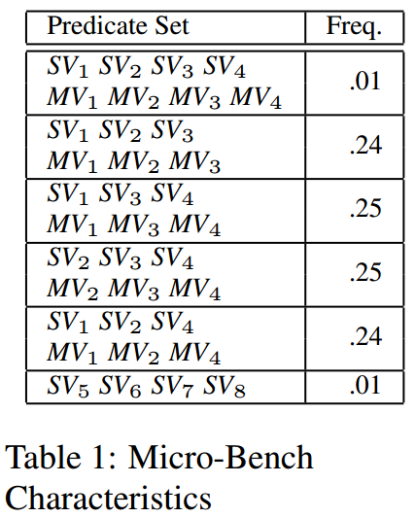
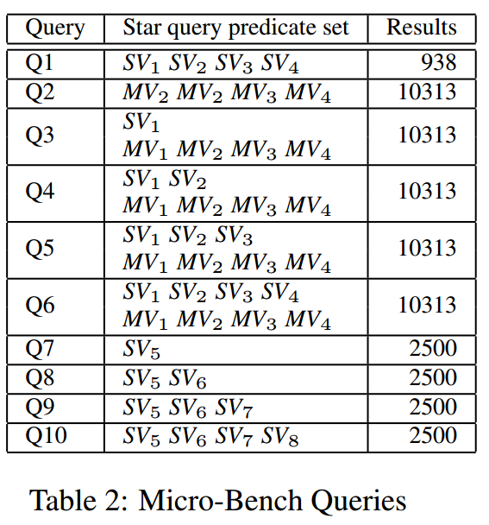
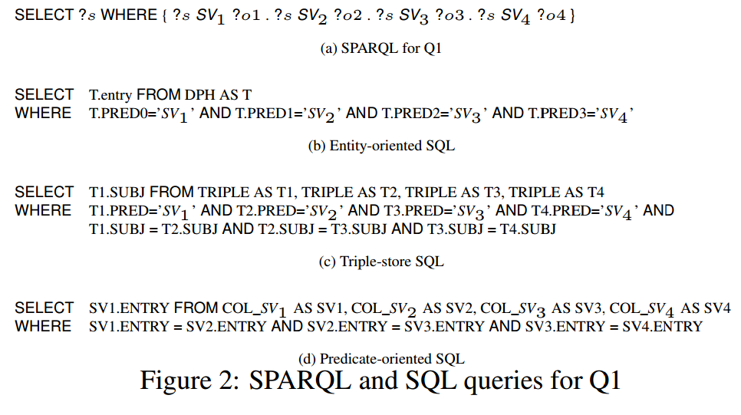

Slide 13
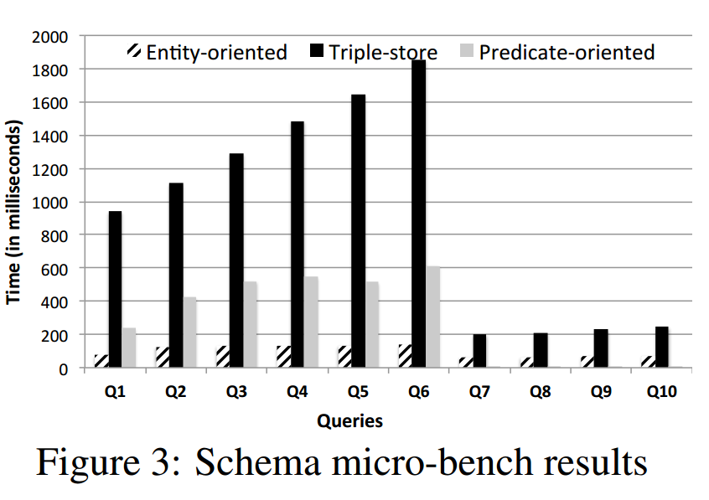
The above figure will compare the results of three storage schemas. -DB2RDF is more stable across different conditions. - performance of predicate-oriented store depends on predicate selectivity's - overall these results suggest that DB2RDF has significant benefits for processing star queries.

Slide 14
Predicate-to-Column Assignment
The key for entity oriented storage is to fit all predicates for a given entity on a single row.
The maximum no. of columns in a relational table is fixed, the goal is to dynamically assign the each predicate to a column such that
The total columns used across all subjects is minimized.
For a subject, mapping two different predicates into same column is minimized to reduce spills, because spills may cause self-joins.

Slide 15
Predicate-to-Column assignment contd.
Predicate Mapping: simply a function, which takes arbitrary predicate p and returns a column number. Assigning predicates to column, typically chose largest containable columns on a single row.
This mapping function doesn’t guarantee that it minimizes spills.
Predicate Mapping Composition: defines a new predicate mapping that combines the column numbers from multiple predicate functions
when the implementation must select a column number in the sequence for predicate insertion
But this negatively affect the data retrival

Slide 16
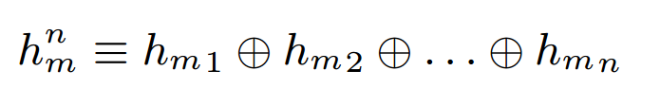
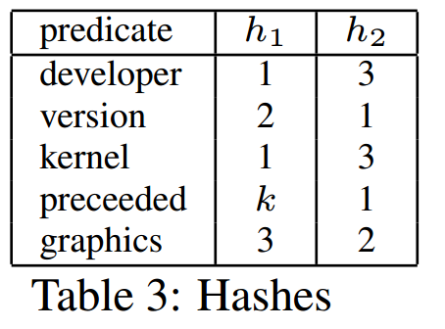
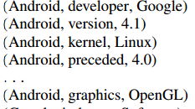
Predicate-to-Column assignment contd.
Here we provide two varieties of predicate mapping functions depending upon whether a sample dataset is available or not. If the sample is not available we use Hash function, otherwise we use Graph Coloring.
Hashing: hash function h_{m} is computed on predicates and restricted to a range from 0 to ‘m’. to minimize spills, compose ‘n’ independent hashing functions to provide the column numbers.

Slide 17
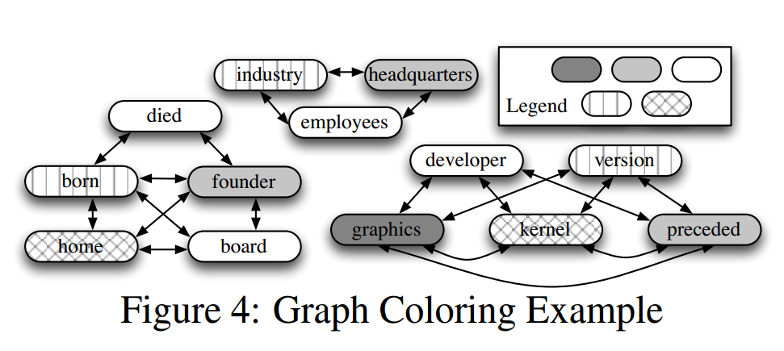
Predicate-to-Column assignment contd.
Graph Coloring: exploiting the dataset to minimize the total no. of columns.
Here we assign predicates that co-occur together to different columns, and vise versa, by creating a graph from predicates, use graph coloring to map predicates to columns.
The no. of colors used will defines the no. of columns required.
When a coloring doesn’t exists, there is no way to put all the predicates into columns, here spill may require.

Slide 18
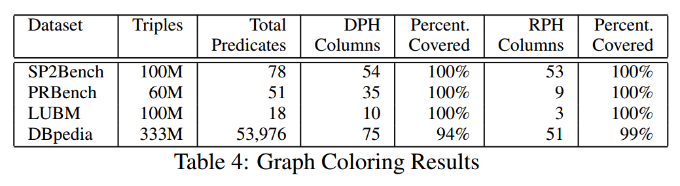
Graph Coloring in practice
The above table shows how the graph coloring will works on different kinds datasets and the percentage of data covered is also mentioned

Slide 19
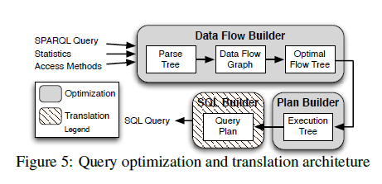
Querying RDF
Two steps:
SPARQL Optimization
Data Flow Builder
Translation to SQL
Plan Builder
SQL Builder

Slide 20
Data Flow Builder (1/4)
The Query Q
SELECT *
WHERE {
?x home “Palo Alto” t1
{ ?x founder ?y UNION t2
?x member ?y t3
}
?y industry “Software” t4
?z developer ?y t5
?y revenue ?n t6
}
OPTIONAL{ ?y employee ?m} t7
}

Slide 21
Data Flow Builder (2/4)
Value | Count
IBM | 7
Industry | 6
Google | 5
Software | 2
Avg. triple per subject | 5
Avg. triple per object | 1
Total triples | 26
Statistics Table S
Access Methods M
Access by Subject (asc)
Access by Object (aso)
Full Scan (sc)

Slide 22
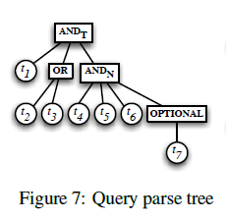
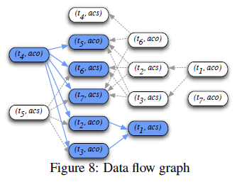
Data Flow Builder (3/4)

Slide 23
Data Flow Builder (4/4)
Condition to add an edge in Data flow graph:
Produced variables 𝒫
Required variables 𝓡
OR connected pattern Û
Optional pattern Ô
t: an triple with access method m.
In plain words the condition would be:
“Add an edge between (t, t’) if and only if produced variables of t are superset of required variables of t’ and (t, t’) aren’t connected with OR pattern and t’ isn’t guarded by t in Optional pattern.”

Slide 24
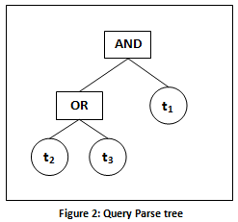
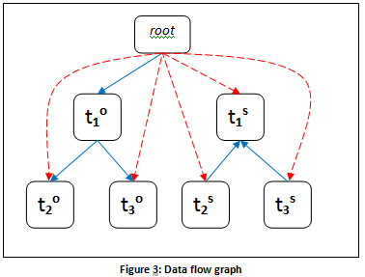
Example(1/2)
Query
SELECT *
WHERE
{
?y industry “Software” t1
{
?x founder ?y UNION t2
?x member ?y t3
}
}

Slide 25
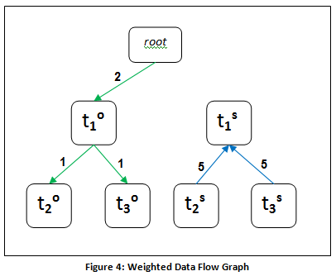
Example (2/2)
Assign weight: ω ← W{(t,m), (t’,m’), S}
?y industry “Software” t1
?x founder ?y UNION t2
?x member ?y t3
Statistics S
Value | Count
IBM | 7
Industry | 6
Google | 5
Software | 2
Access cost by subject | 5
Access cost by object | 1
Total triples | 26

Slide 26
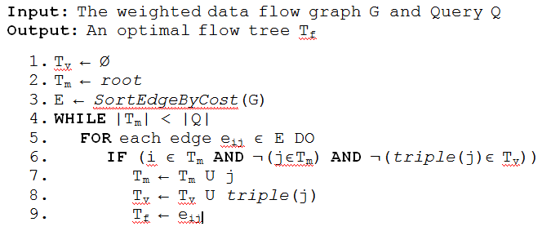
Finding Optimal Tree(1/2)
T_{f}: Optimal Flow tree/ Execution tree
T_{v}: Visited Triples (included in T_{f} tree)
T_{m}: Triples with Access Method (T₁º, T₁^{S} etc.)
Pseudo Code:

Slide 27
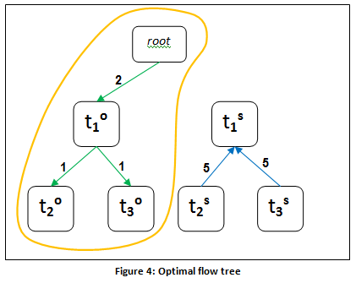
Optimal Tree (2/2)
Sort the Edges
Start from root
In each iteration pick the edge with minimum cost
Check the conditions and add the edge to tree if satisfied.

Slide 28
Query Plan Builder
Relying on SQL database engine to optimize a translated SPARQL query might be sufficient.
However, “huge performance gains can occur when SPARQL and the SPARQL to SQL translation are independently optimized”.
Utilize the data flow graph and the query parse tree to generate an execution tree.
The execution tree is then optimized and translated to SQL by the SPARQL to SQL Translator.

Slide 29
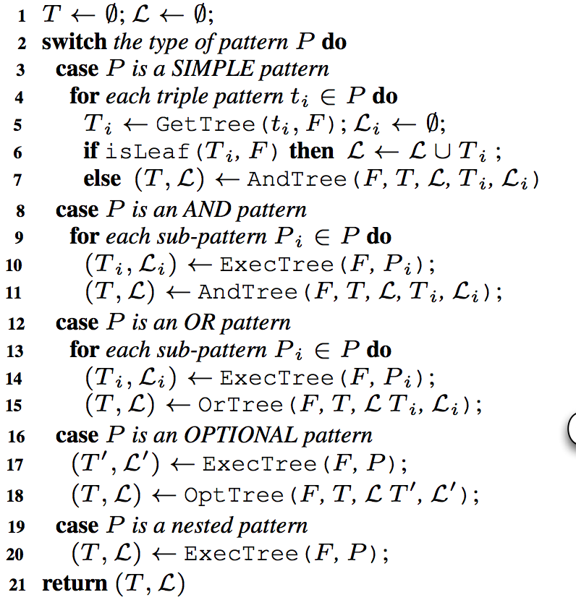
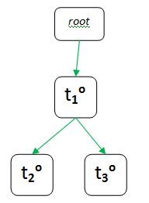
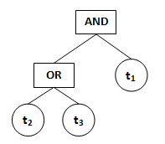
Query Plan Builder: Execution Tree

Slide 30

Query Plan Builder: Execution Tree

Slide 31
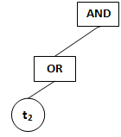

Query Plan Builder: Execution Tree

Slide 32
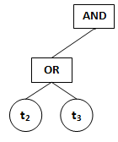

Query Plan Builder: Execution Tree

Slide 33


Query Plan Builder: Execution Tree

Slide 34
Query Plan Builder: Query Plan Tree
Structural merge constraints:
Same entity
Same access method
Semantic merge constraints:
AND-Mergeable
OR-Mergeable
OPT-Mergeable
SELECT *
WHERE
{
?y industry “Software” t1
{
?x founder ?y UNION t2
?x member ?y t3
}
}

Slide 35
Query Plan Builder: Query Plan Tree
Structural merge constraints:
Same entity
Same access method
Semantic merge constraints:
AND-Mergeable
OR-Mergeable
OPT-Mergeable

Slide 36
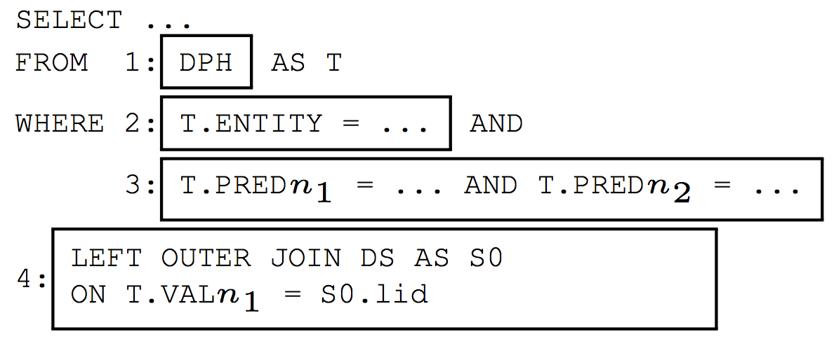
SQL Translation
Traverse the query plan tree:
Produce node equivalent SQL using template:

Slide 37
SQL Translation
SELECT *
WHERE
{
?y industry “Software”. t1
{ ?x founder ?y. t2 UNION ?x member ?y. t3 }
}

Slide 38
SQL Translation
WITH QT1RPH AS SELECT T.val1 AS val1 FROM RPH AS T
WHERE T.entry =’Software’ AND T.pred1 =’industry’,
QT1RS AS SELECT COALESCE (S.elm, T.val1) AS y FROM QT1RPH AS T LEFT OUTER JOIN RS AS S ON T.val1 =S.l_id

Slide 39
SQL Translation
WITH QT1RPH AS SELECT T.val1 AS val1 FROM RPH AS T
WHERE T.entry =’Software’ AND T.pred1 =’industry’,
QT1RS AS SELECT COALESCE (S.elm, T.val1) AS y FROM QT1RPH AS T LEFT OUTER JOIN RS AS S ON T.val1 =S.l_id
QT23RPH AS
SELECT QT1RS.y,
CASE T.pred_{m} =’founder’ THEN val_{m} ELSE null END AS val_{m},
CASE T.pred₀ =’member’ THEN val₀ ELSE null END AS val₀
FROM RPH AS T, QT1RS
WHERE T.entry =QT1RS.y AND (T.pred_{m} =’founder’ OR T.pred₀ =’member’),
QT23 AS
SELECT COALESCE (T.val_{m}, T.val₀) AS x, T.y FROM QT23RPH as T,
WHERE T.val_{m} IS NOT NULL
OR T.val₀ IS NOT NULL

Slide 40
THANK YOU

